Slide 1



Offroad Terrain Segmentation Using Deep Learning
Pixel-LevelSceneUnderstanding for Autonomous Offroad Navigation
TECH TITANS
• Saunak Sharma
• Prashant Dwivedi

Slide 2
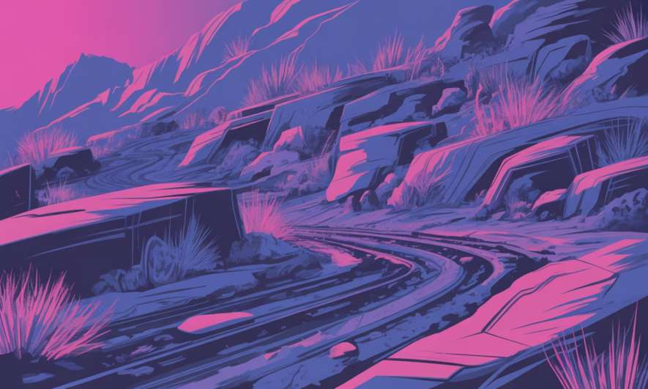
The Challenge of Unstructured Environments
Why Offroad Segmentation Matters
Traditional navigation systems fail in offroad environments. These terrains lack the structured cues vehicles rely on—no lane markings, no clear boundaries, just raw unpredictability.
•
Highly unstructured terrain with irregular
surfaces
Dynamic obstacles including rocks,
vegetation, and elevation changes
High visual ambiguity under varying
lighting and weather
•
•
Our Goal:Enable autonomous systems to
understand offroad scenes at the pixel level.

Slide 3


Problem Statement
Pixel-Level Classification
Assign semantic meaning to every pixel in an image, creating dense scene understanding beyond object detection.
Multi-Class Terrain Recognition
Distinguish between vegetation, rocks, sky, landscape, and background with high precision across diverse conditions.
Generalization to Unseen Data
Build a robust model that performs reliably on new offroad environments not encountered during training.
We aimed to develop a deep learning–based semantic segmentation system capable of real-world deployment in
autonomous offroad navigation scenarios.

Slide 4
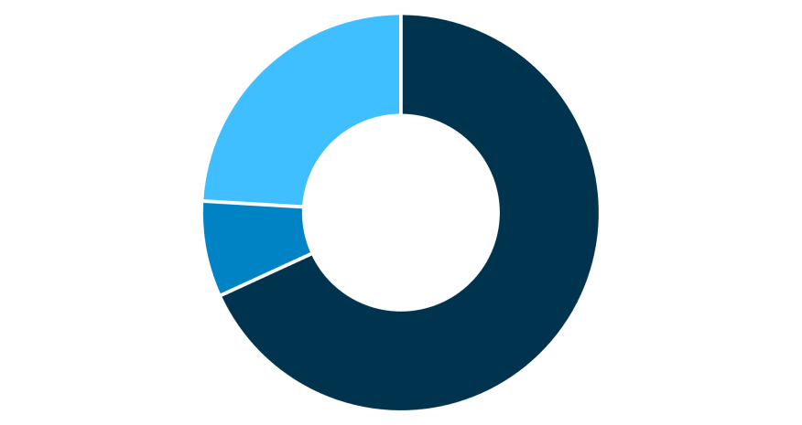



Dataset Overview
Dataset Composition
Our dataset consists of RGB offroad images paired with pixel-wise annotated segmentation masks. Each pixel is labeled with its corresponding terrain class.
Total Dataset:4,176 annotated images Classes:Background, vegetation, rocks,
landscape, sky, and additional terrain
features The split ensures robust training while
maintaining sufficient validation and test
data for reliable performance evaluation
on unseen environments.
Training
Validation
Test

Slide 5


Model Architecture: DINOv2 + Segmentation Head
Why DINOv2?
We selected DINOv2 (Vision Transformer)as our backbone architecture, leveraging its self-supervised pretraining for superior feature extraction.
Architecture Components
Backbone:DINOv2 Vision Transformer for hierarchical feature extraction
Segmentation Head:Custom decoder for pixel-level classification
across multiple terrain classes
Output:Dense semantic map with per-pixel class predictions
Strong Visual Representations
Better Generalization
Data Efficiency
Self-supervised learning createsrobust features without manual labels
Pretrainedon diverse imagery improves performance on novel terrains
Works effectivelywith limited labeled training data

Slide 6

Training Pipeline
Framework
PyTorch for flexible model development and efficient training workflows
Environment
Anaconda for reproducible dependency management and environment isolation
Hardware
Optimizer
CUDA-enabled GPU acceleration for efficient batch processing and training
Adam optimizer with adaptive learning rates for stable convergence
End-to-end training was performed with continuous validation monitoring to track model performance and prevent
overfitting throughout the learning process.

Slide 7




Evaluation Metrics
Intersection over Union (IoU)
Measures overlap between
predicted and ground truth segmentation masks. Primary metric for assessing segmentation quality.
Dice Coefficient
Evaluates similarity between
prediction and groundtruth,with emphasis on pixel agreement. Ranges from 0 to 1.
Pixel Accuracy
Percentage of correctly classified
pixelsacrossthe entireimage. Provides overall classification performance.
IoU is the gold standardfor semantic segmentation evaluation, as it penalizes both false positives and false negatives equally.

Slide 8
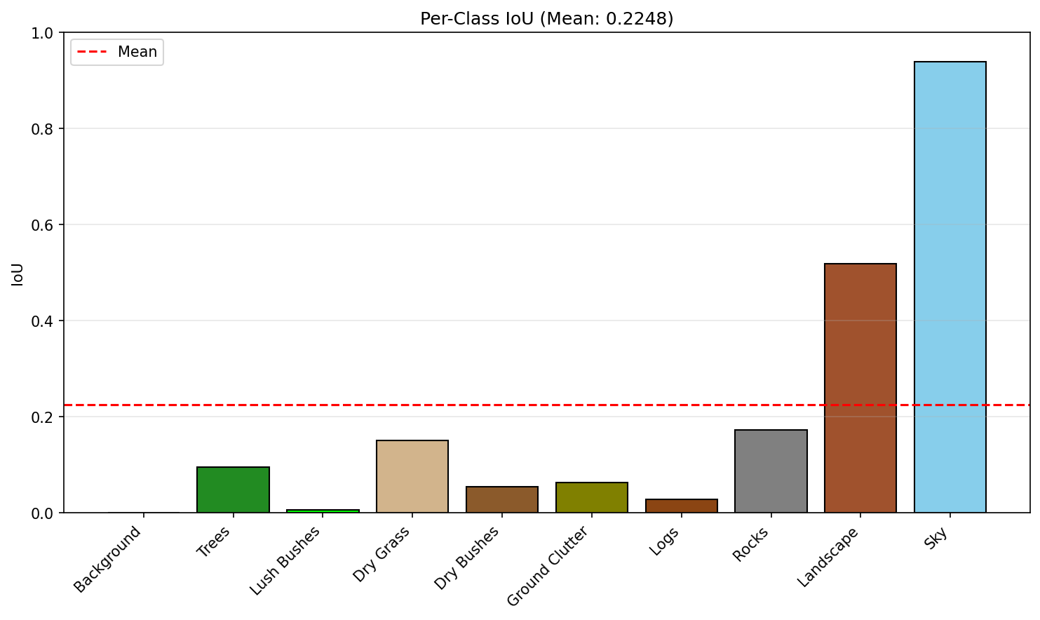
Visual Representation & Graph
.

Slide 9
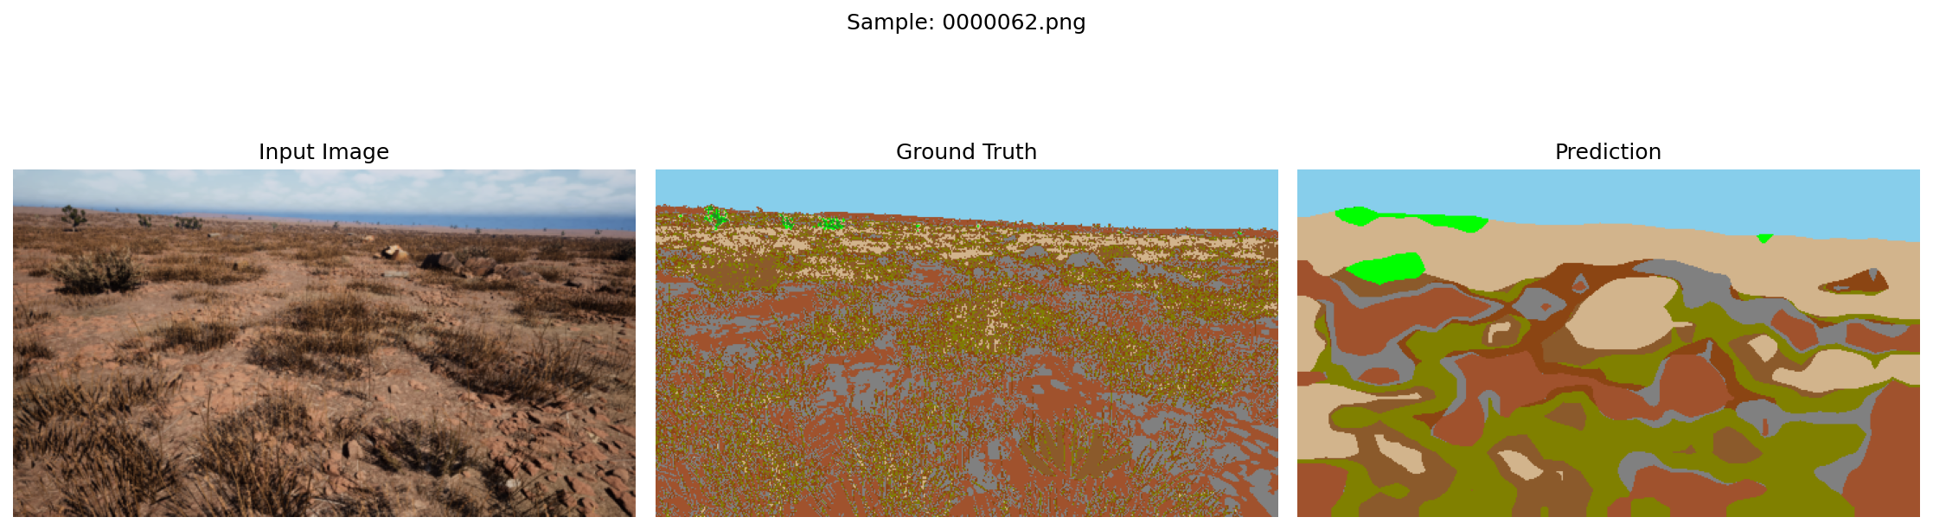
Sample Comparison:
.

Slide 10
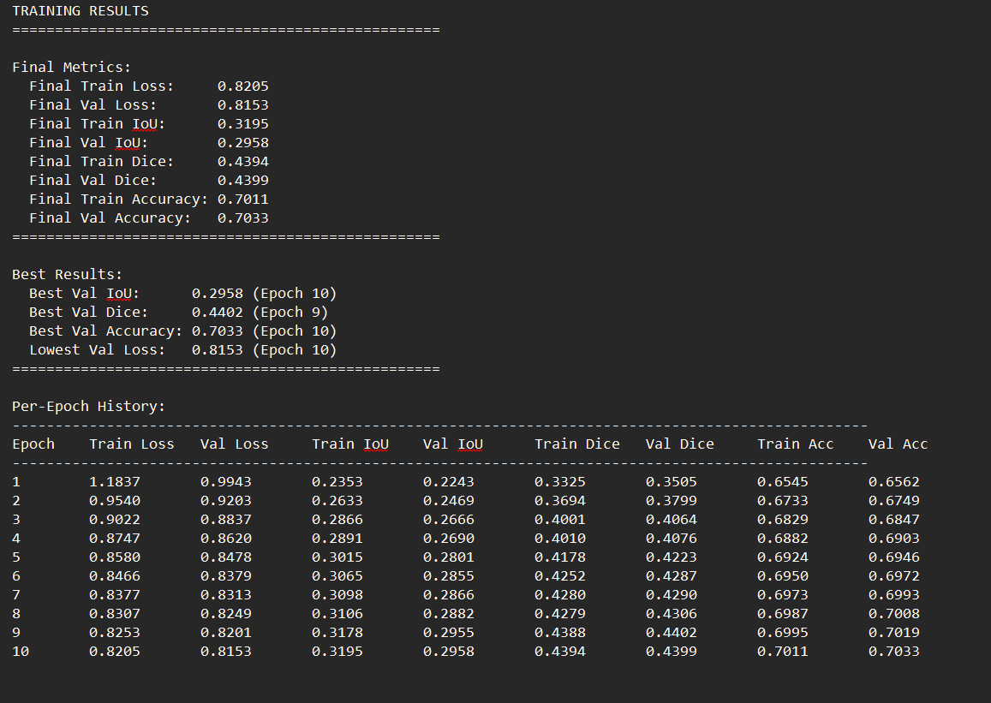
Training Results:
.

Slide 11
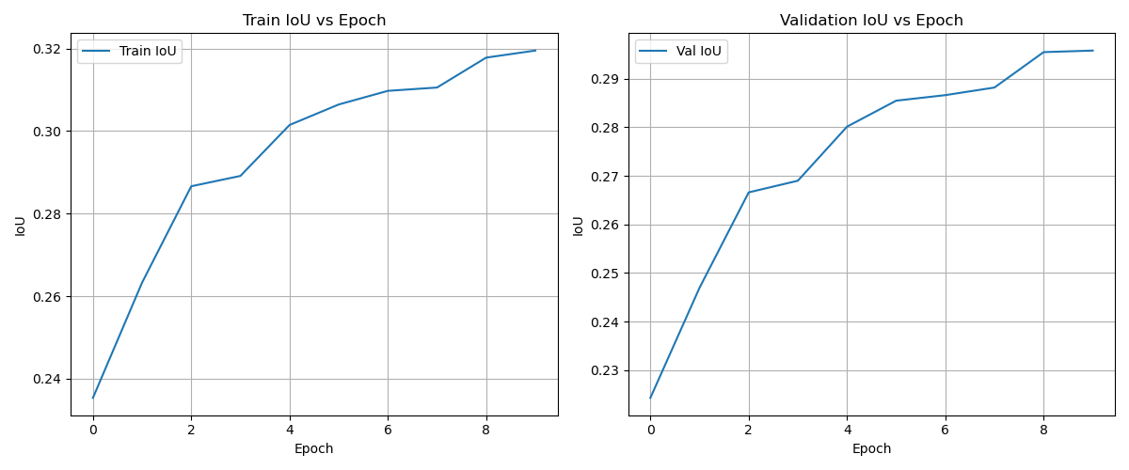
Train IoU Curves:
.

Slide 12
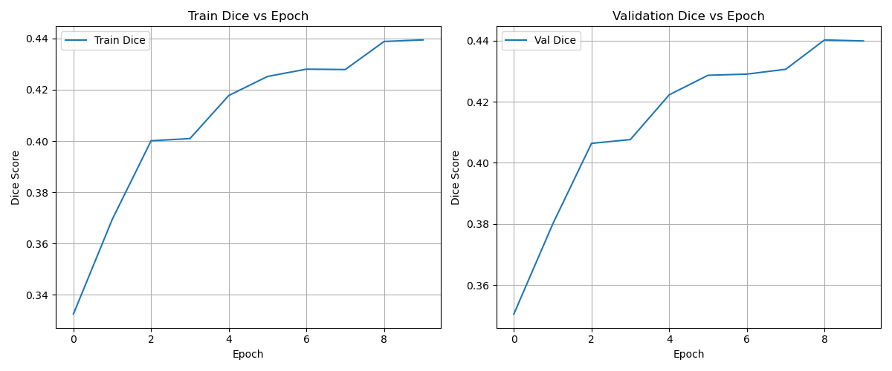
Dice Curves:
.

Slide 13
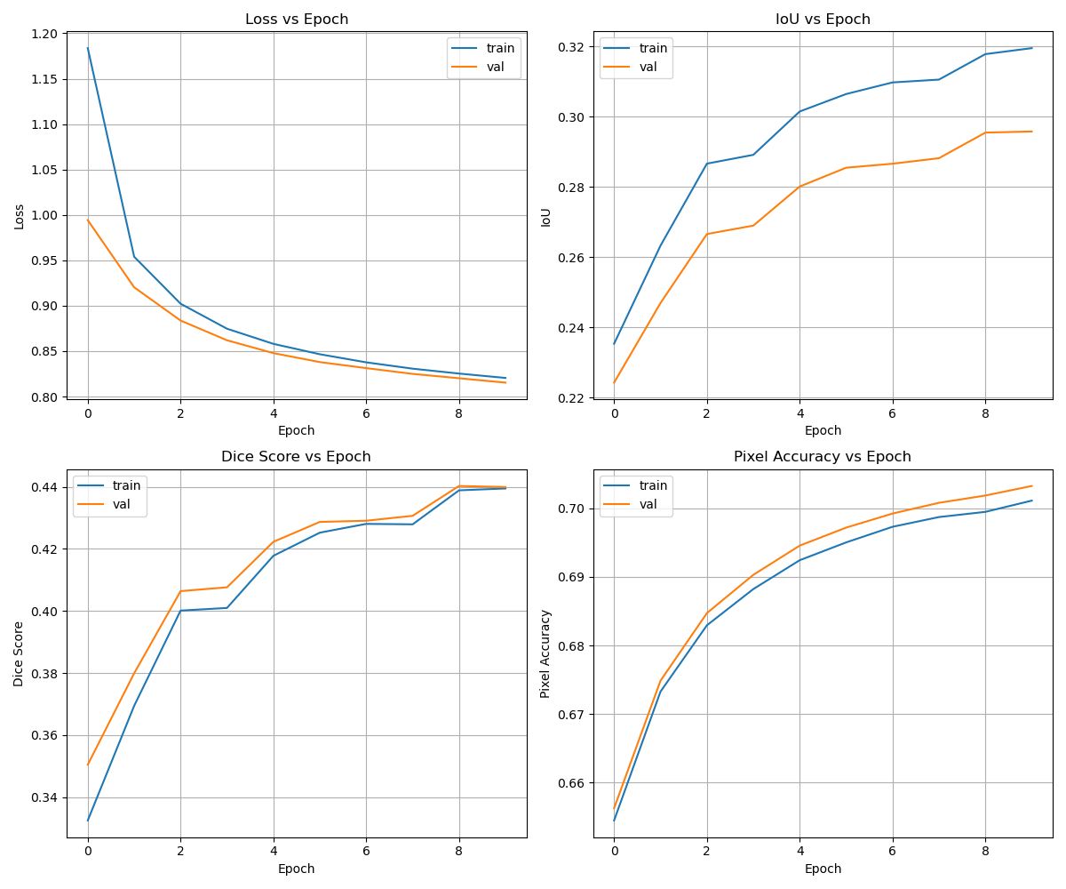
All Metric Curves:
.

Slide 14



Performance Results
Validation Performance
30%
44%
70%
IoU
IntersectionoverUnion score
Dice Score
Pixel Accuracy
Segmentation similarity
Correctclassifications
Test Set Generalization
The model was evaluated on completely unseen offroad terrain data to assess real-world performance.
Test Mean IoU: 0.2248 While the test IoU is lower than validation, this demonstrates the model's ability to generalize beyond training data—a criticalrequirement for
deployment in diverse offroad environments.
The 70% pixel accuracy on validation indicates strong overall classification performance across terrain classes.

Slide 15



Key Achievements
End-to-End Pipeline
Advanced Feature Learning
DINOv2 backbone significantly improved feature extraction, enabling the model to capture complex terrain patterns without
extensive manual engineering.
Generalization Capability
Successfully built and validated a complete segmentation system from data preprocessing through model training to deployment-ready inference.
Demonstrated reasonable performance on unseen test data, validating the model's potential for real-world autonomous navigation applications.

Slide 16
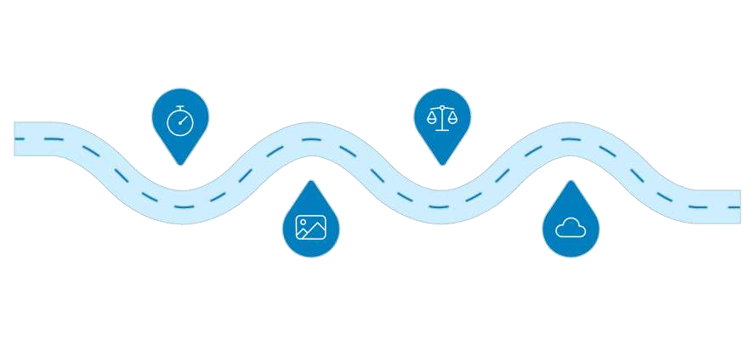
Future Directions
Planned Enhancements
Extended Training
Trainlongertoimprove
Class Balancing
Reweight or resample
•
Extended Training:Additional epochs to improve convergence and model capacity Advanced Augmentation:Enhanced data augmentation strategies for better robustness Class Imbalance:Weighted loss functions to handle underrepresented terrain classes Real-Time Inference:Model optimization for low-latency deployment on edge devices
convergence
to fix imbalance
•
•
•
Data
Real-time
Augmentation
Apply advanced
Deployment
Serve models with low-latency inference
These improvements will bridge the gap
between research prototype and production
deployment in autonomous offroad navigation
systems.
augmentations at scale
Clear pathway to production-ready performance through systematic enhancements.

